Slide 1
US Craft Beer Market
Linda Eliasen
Limin Zheng

Slide 2
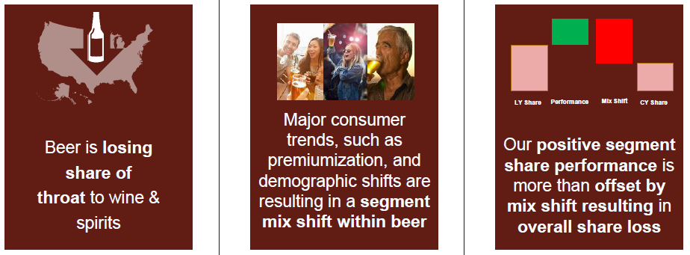
Budweiser – Current Outlook
Top-line growth below initial expectations
Volumes under pressure from a softer industry and segment shift mix within beer
Growth opportunity focused on category expansion framework
Capital Allocation Objectives:
Organic growth
Selective M&A
https://www.ab-inbev.com/content/dam/universaltemplate/ab-inbev/investors/reports-and-filings/quaterly-reports/2018/10/AB%20InBev%203Q18%20Results%20Presentation.pdf

Slide 3
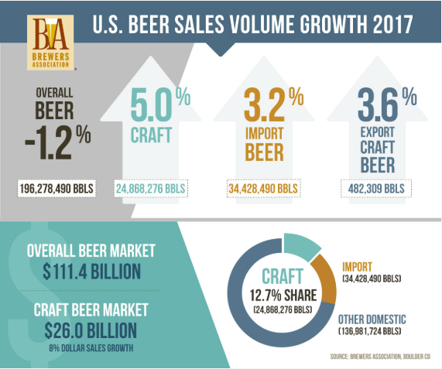
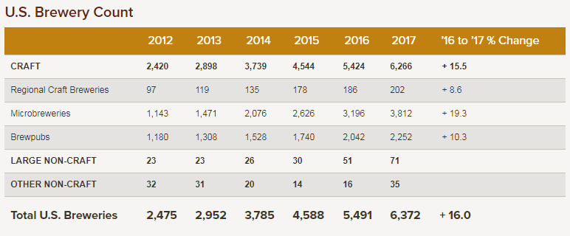
United States Craft Beer Market
https://www.brewersassociation.org/

Slide 4
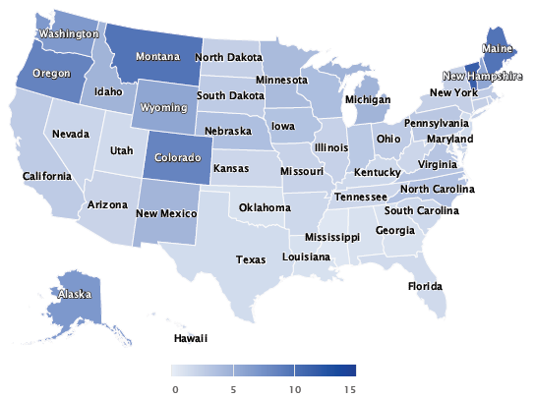
Craft Beer Breweries Per Capita
*per 100,000 21+ Adults

Slide 5
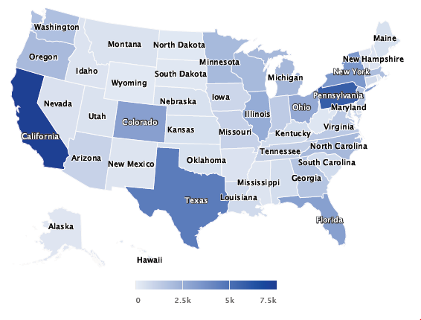
Economic Impact (M$)
*Economic impact data is from 2016

Slide 6
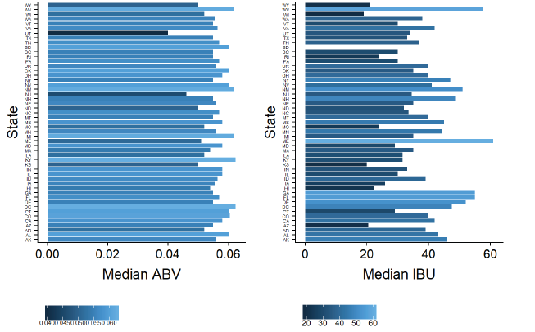
Consumer Preferences – ABV / IBU

Slide 7
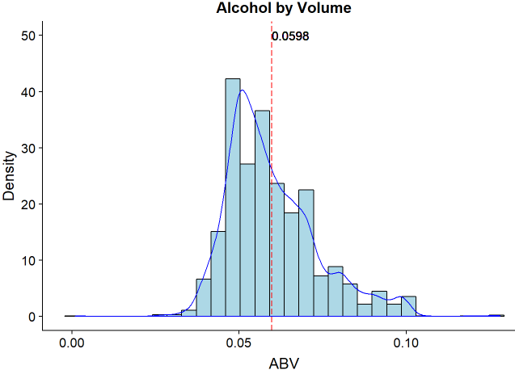
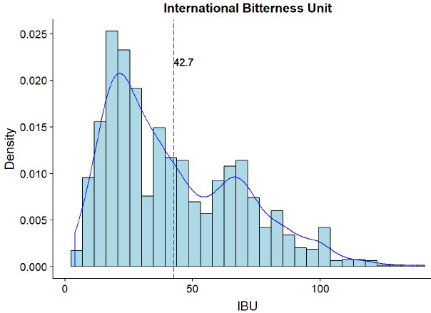
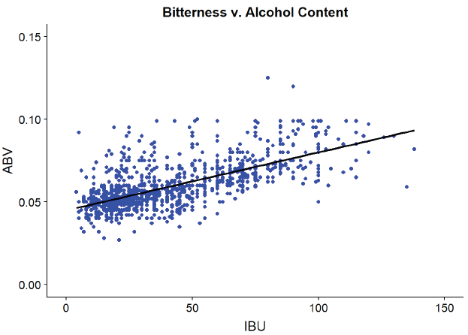
Consumer Preferences – ABV / IBU
Consumers tend to favor beers with lower alcohol content
Taste preferences gravitate towards beers with bitterness ratings below the average of 42.7
Those that prefer higher IBU, fall in the preference range of 60 – 75 IBUs
A positive linear relationship exists between bitterness and alcohol content and clustering mirrors the histograms heavier clustering is evident at the mix of .06 ABV and 40 IBUs. Linear regression results indicates the relationship between ABV and IBU is statistically significant.

Slide 8
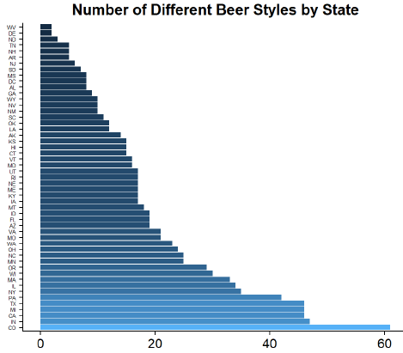
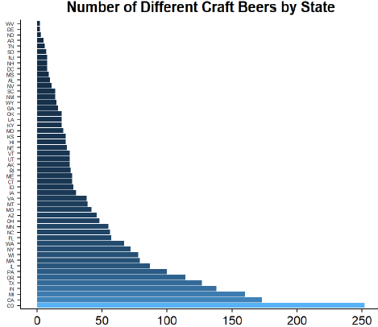
United States Craft Beer Market

Slide 9
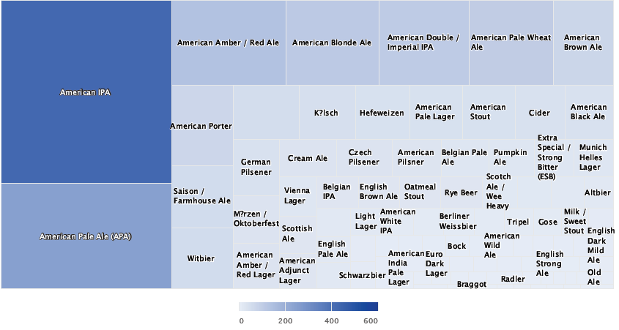
Consumer Preference - Craft Beer Style

Slide 10
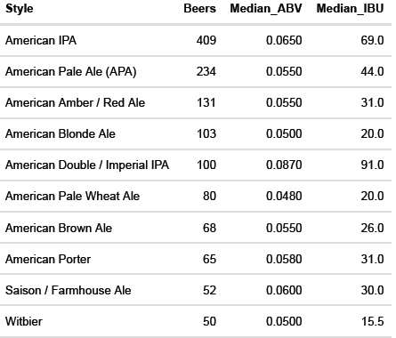
Consumer Preference - Craft Beer Style
American India Pale Ale is the most popular craft beer style
American Pale Ale second most popular; steadily increasing

Slide 11
Recommendation
Re-entry into the craft beer market at the mid-scale level
Product development geared towards American Pale Ales
Market saturated with American IPAs
Sierra Nevada significant market leader and current strategy focused on increasing market share
Extremely competitive and difficult for new beers to gain market share
American Pale Ales continue to gain popularity
Crafters experiment with local ingredients to push flavor profile boundaries
Consumers gravitating towards the wide array of interesting and complex flavors, supporting small/mid size batch processing

Slide 12
Recommendation
Focus on the Midwest Region. Western market saturated.
Existing brewery locations: Ohio and Missouri
Ideal market based on craft beer economic impact statistics and potential market growth
Key states in the region

Slide 13
Organic Growth: Craft Brewery Site - Illinois
Ranked 8 for economic impact of craft beer market
Proximity for sourcing fresh hops from the Pacific Northwest (preferred consumer flavor profile)
Ideal location for serving Michigan, Wisconsin and Minnesota
Potential Ingredient economy of scale with Missouri brewery
Utilize Missouri’s distribution network
Future growth potential into the Eastern Region via Ohio brewery and distribution network
Requires sourcing a Master Brewer from the craft brew world

Slide 14
Selective M&A: Regional Acquisition Western Region
Anderson Valley Brewing Company & Tap Room - Boonville, CA
Founded in 1987 with a 10 barrel brewhouse.
Expansion in 1996 to 26 acre property. Includes a 100-barrel brewhouse, tasting room, beer garden, and the first 18-hole disc golf course ever to be built at a brewery.
Hand crafted Ales and Lagers
2011 – exclusive partnership with Wild Turkey Bourbon to develop a line of bourbon barrel aged-beers.
https://avbc.com/

Slide 15
We appreciate the opportunity to partner with you on this critical endeavor. The detailed report of our analysis has been emailed.
If you have additional questions feel free to contact us:
leliasen@mail.smu.edu
lzheng@mail.smu.edu

